Slide 1

Grocery Store Managment

Slide 2
About me
Background? (B-tech or M-tech)
Why you want to learn Data Science
Any work experience
Share your LinkedIn and GitHub profile URLs

Slide 3
Agenda (This should be the PPT flow)
Objective of the Project
ER Diagram and schema explanation
Key analysis questions (use cases)
SQL query results with screenshots or summaries
Final business insights and recommendations
Conclusion (Key finding overall)
Q&A Slide
Your Experience/Challenges working on SQL – Data Analysis Project.

Slide 4
Objective of the Project:
🛒 Build a relational database to manage suppliers, products, customers, employees, and orders.
📊 Retrieve and analyze data using SQL to understand sales, customers, and product performance.
📈 Identify business insights such as top customers, best-selling products, and revenue trends.
⚡ Improve operational efficiency through better decision-making and resource management.

Slide 5
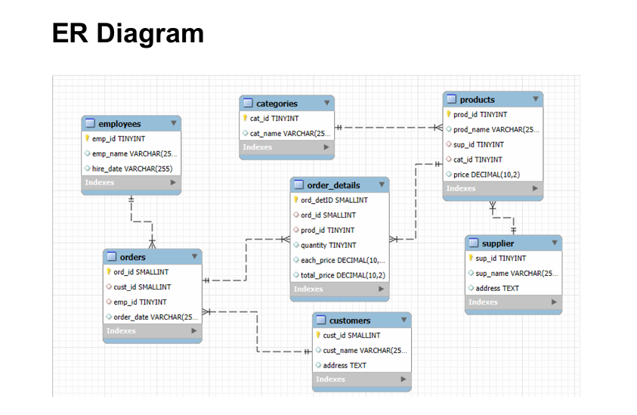

Slide 6
Key analysis questions :
🔹 1. Customer Insights
🔹 2. Product Performance
🔹 3. Sales and Order Trends
🔹 4. Supplier Contribution
🔹 5. Employee Performance

Slide 7
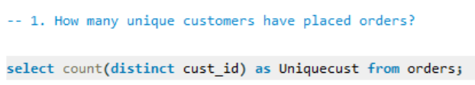
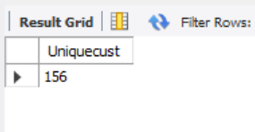

Slide 8
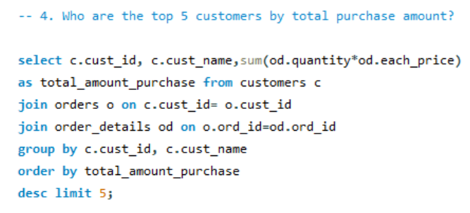
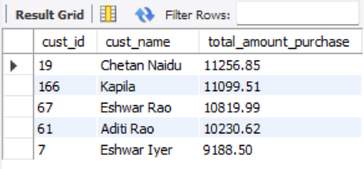

Slide 9
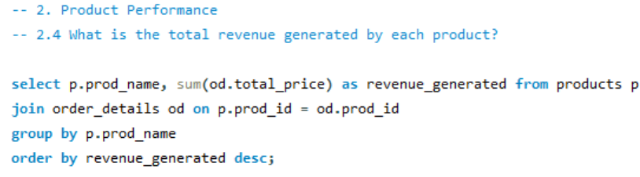
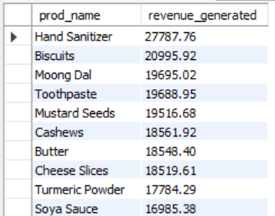

Slide 10
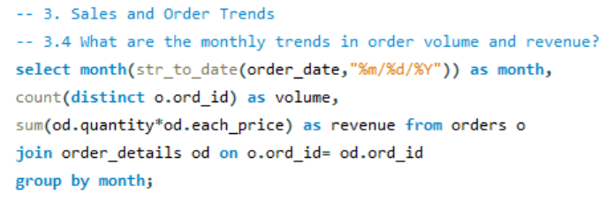
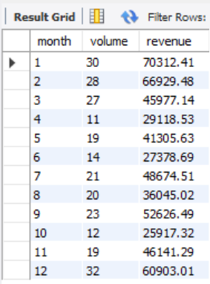

Slide 11
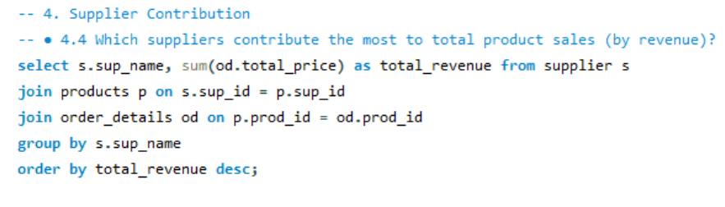
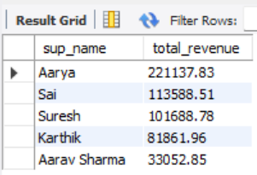

Slide 12
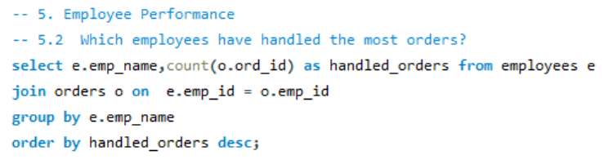
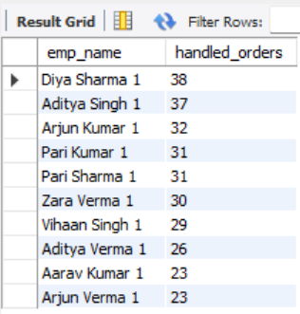

Slide 13
Final business insights and Recommendations :
Launch loyalty programs for repeat customers
Focus on best-selling products, reduce slow movers
Run seasonal & weekend promotions
Diversify suppliers to reduce risk
Train & reward employees for performance

Slide 14
Conclusion :
The project demonstrates how a structured relational database
can simplify and optimize grocery store operations.
SQL-based analysis provides clear visibility into customers,
products, suppliers, and employees.
By integrating data insights into decision-making,
the store can move towards
smarter inventory control, stronger customer relationships,
and sustainable growth.

Slide 15
Q&A Slide

Slide 16
Experience Gained:
Gained hands-on practice in designing and implementing a relational database.
Learned how to analyze real-world business problems with data-driven insights.
Enhanced understanding of data relationships between customers, products, suppliers, and employees.

Slide 17

THANK YOU

